Slide 1
Gaurav-Ghorpade-Team
Gaurav Ghorpade

Slide 2
Methodology
Dataset used:
Tabular data provided by Shell for Hackathon.
Images were not used.
No external dataset used.
Pre Processing:
Data Cleaning pertaining to Total Cloud Cover Column was carried out where values outside [0,100] were not included in model.
Some basic feature engineering was carried out. Three sets of models were completed during Stage 1 and one set of model was incomplete. Each set has 4 models corresponding to horizons.
Feature Engineering involved creation of lag variables. Lags at 10, 30 and 60 minutes were considered.
At each lag, raw sensor value as well as difference between value of sensor/feature between current time and historical time was considered.
Other than first set of model, remaining models used a median filter (10min window) to smooth out the data.
Median filter model improved my score which was reflected in Hacker Earth initially.
After competition was over there was some bug in HackerEarth platform and this submission is not evaluated.

Slide 3
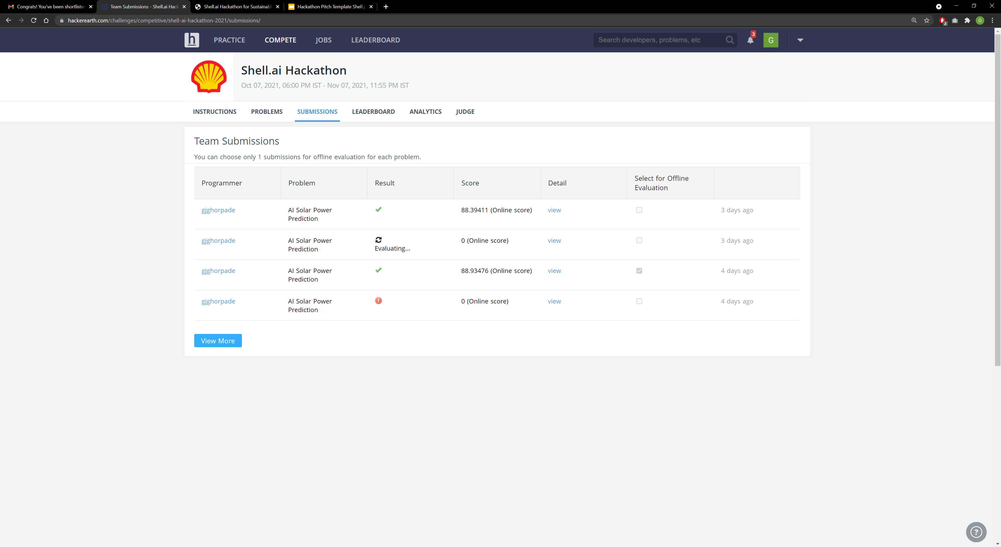
Hacker Earth Bug
This submission scored 89+
Stuck on Evaluating after competition over.
It evaluated quickly while competition was ongoing.

Slide 4
Experiment Results
Model Number | Model Class | Default Parameters Used | Median Filter Used for Preprocessing | Lag Features Used | Completed during Stage 1 | Online Submission Score
1 | Catboost | Yes | No | Yes | Yes | 88.93
2 | Catboost | Yes | Yes | Yes | Yes | 89+
3 | Catboost | No | Yes | Yes | Yes | 88.39
4 | LSTM | No | Yes | Yes | No | -
Experiment Results
Model details
Did you use pre-existing model or customized it for the submission?
Ans: Custom Model
Did you use any transfer learning ?
Ans: No
Performance details
What did you change to improve Performance of training the network?
Median Filter + Lagged Variables for Catboost
The LSTM was not complete by the time stage 1 ended but adding more units and some small dropout allowed me to train more epochs without overfitting

Slide 5
Final Solution
Hardware used for Stage 1
Did you use or any accelerators for same?: No
Did you use your own desktop/cloud/cluster for the Stage 1?:Own Desktop
Software packages used for Stage 1
Which all framework and libraries were used to get to solution?
Pandas, Numpy, Sklearn, Scikit-Learn, Catboost, os, matplotlib,
Tensorflow+Keras (used for LSTM not completed during Stage 1)
Performance Numbers: ( GPU/CPU Details )
Training Times : How much total hours were spent on training to get the final best score?
Total Development Time for Hack : approx. 1.5 days
Total Preprocessing and training time for final solution: approx. 4 mins
Total Training time for each model approx. 36 seconds, 4 models = 2.5 minutes
Catboost Training Performed on CPU. CPU SPECS: AMD 5600x+32 GB RAM+SSD
LSTM Training Performed on GPU.
License:
Is the solution available Open Source or Closed ?
If organizers want the notebook, I can share it.
What is the license of Solution?
MIT License (? I am not sure, I just randomly selected)

